Slide 1

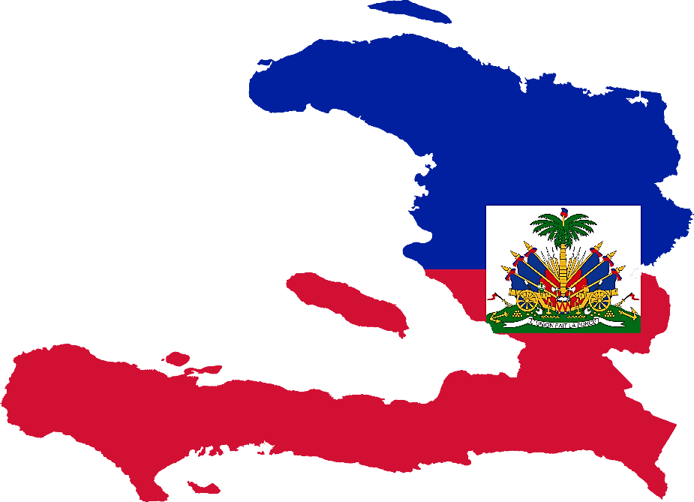
Puits Blain 11, 2ieme impasse Toussaint # 25. Petion Ville Haiti
Phone : + 509-37610501
Email: ppredestin@gmail.com

Slide 2
My Father's House Haiti

Slide 3

MY FAMILY

Slide 4
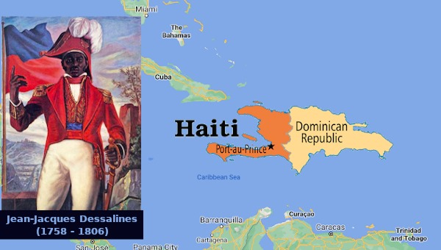

The recorded history of Haiti began on December 5, 1492, when Christopher Columbus landed on a large island in the region of the western Atlantic Ocean that later came to be known as the Caribbean1. Haiti was a French colony from 1697 to 1804, when it became the first independent nation in Latin America and the Caribbean, and the first black-led republic in the world1. In the early 1820s, Haiti invaded Santo Domingo and incorporated the former Spanish colony into a Hispaniola-wide Haiti2. In 1844, Dominicans rejected Haitian hegemony and declared their sovereignty

Slide 5

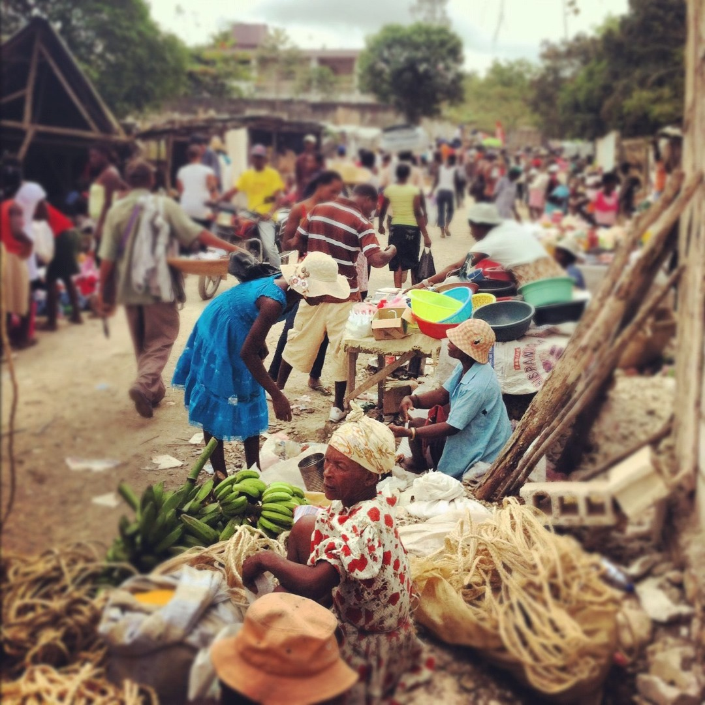
HAITIAN
CULTURE

Slide 6
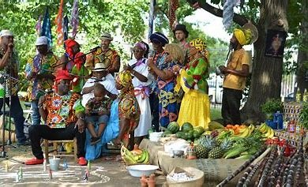
HAITIAN
CULTURE

Slide 7


Slide 8
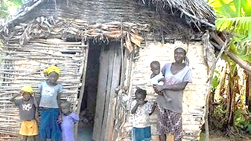
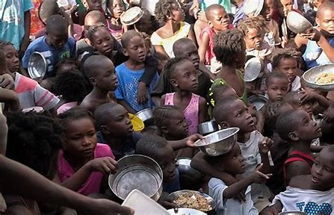
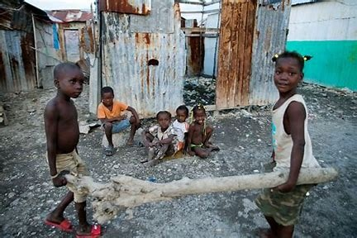
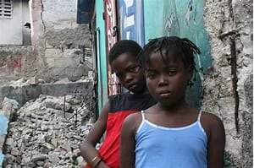

Slide 9
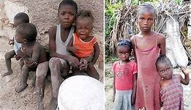

Slide 10

The 2010 earthquake in Haiti was a magnitude 7.0 to 7.34 earthquake that occurred on January 12, 2010 at 16 hours 53 minutes and 10 seconds local time. Its epicenter is located approximately 25.3 km from Port-au-Prince, the country's capital. The focus (or hypocenter) of the quake was located at a depth of 10 km. A dozen secondary tremors were recorded in the hours that followed, with magnitudes ranging from 5.02 to 5.95. The intensity of this quake was around 7.0 at the epicenter3.A second earthquake5,6 with a magnitude of 6.1 occurred on January 20, 2010 at 6:03 a.m. local time. Its focus is located approximately 59 km west of Port-au-Prince, less than ten kilometers below the surface. The first earthquake left many dead, injured and amputees, in addition to thousands of people suffering from psychological disorders. On February 9, 2010, they confirmed that more than 280,000 people were dead, 300,000 injured and 1.3 million homeless.
After Those Erathquakes, The Number Of The Children Of The Orphanage Increased From 25 To 220 Orphans.

Slide 11
My Father's
House Haiti

Slide 12
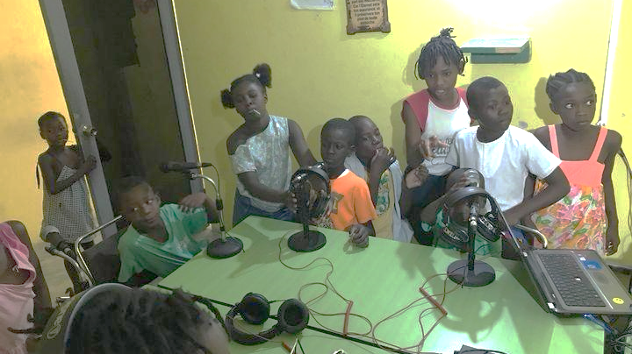

Slide 13
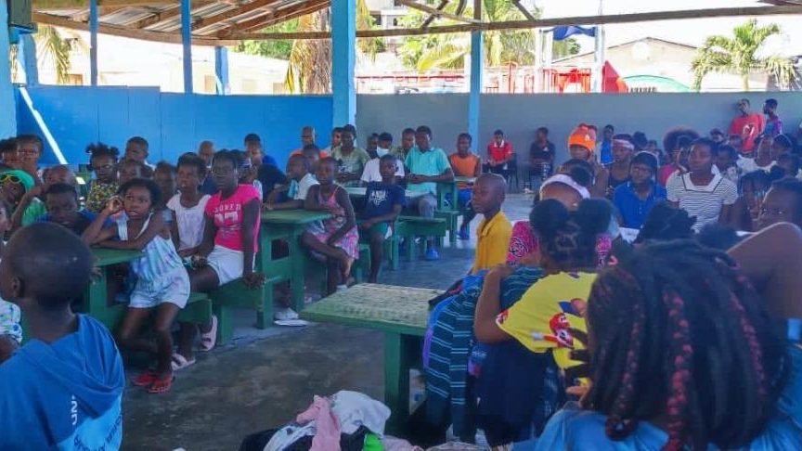

Slide 14
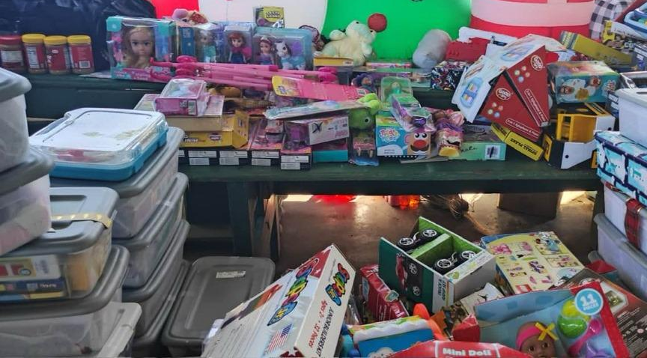

Slide 15
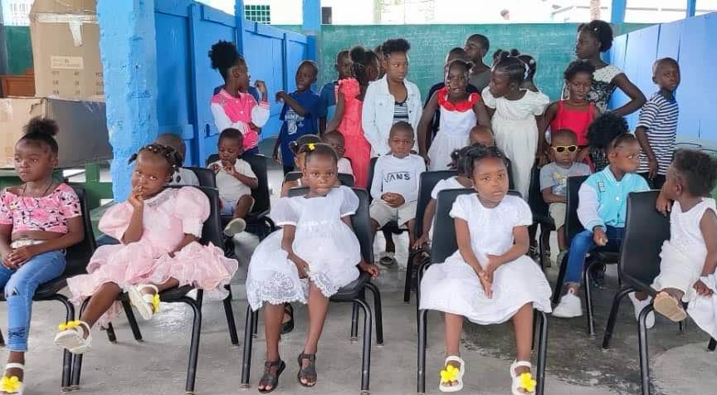

Slide 16


Slide 17
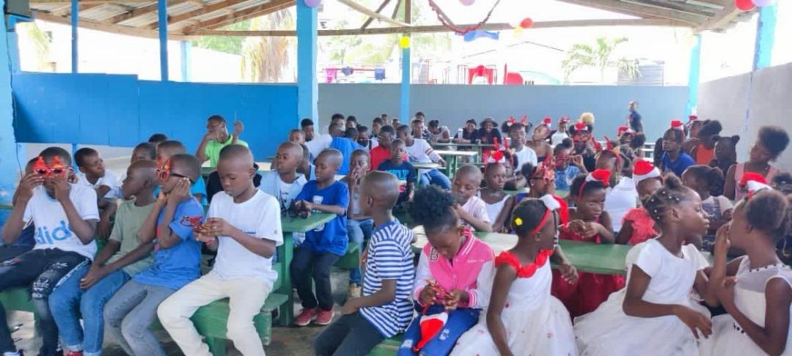

Slide 23
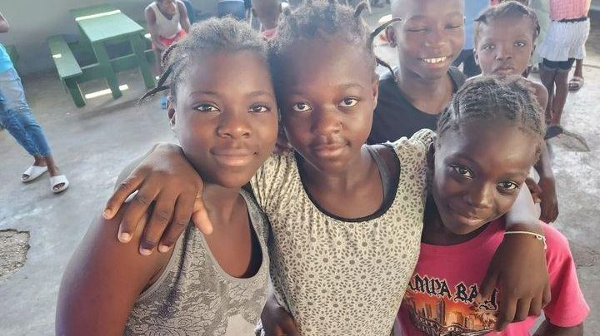
Many orphaned and abandoned children have come to the orphanage, but they've also come with all kinds of problems. When they come, we have to feed them, educate them, give them a home to live in, send them to hospital, educate them in a Christian way and so on.Despite all these challenges, the Lord had never abandoned us and shows us his faithfulness at every moment.Here are a few photos of the services we provide for the children while they are at the orphanage.
HISTORY OF THE FOUNDATION OF MY FATHER'S HOUSE HAITI

Slide 24
Many orphaned and abandoned children have come to the orphanage, but they've also come with all kinds of problems. When they come, we have to feed them, educate them, give them a home to live in, send them to hospital, educate them in a Christian way and so on.Despite all these challenges, the Lord had never abandoned us and shows us his faithfulness at every moment.Here are a few photos of the services we provide for the children while they are at the orphanage.
HISTORY OF THE FOUNDATION OF MY FATHER'S HOUSE HAITI

